Slide 1
Udacity
Marketing Analytics
Nanodegree Program
Project: Craft a Report

Slide 2
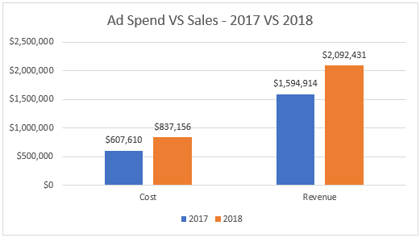

Objective Results
The objective of increasing sales by 30% on Black Friday 2018 against 2017 was met, since it attained na increase of 31%.
The objective of decreasing ad spend by 30% from Black Friday 2017 against 2017 was not met, as a value of 38% increase was the reported value.
The growth formulas are: Cost2018/Cost2017-1
Revenue2018/Revenue2017-1

Slide 3
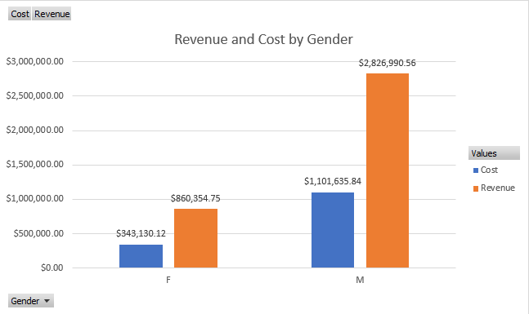

Evaluate the Audience
Question: Which gender generated most sales and cost?
The male gender generated 76.25% and 76.67% of the Cost (1,101,636$) and Revenue (2,826,991$), respectively, more than women on both aspects.

Slide 4
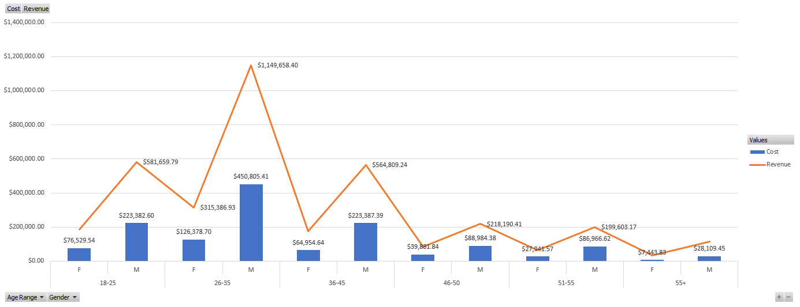
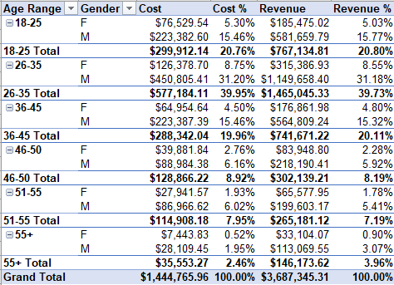
Evaluate the Audience
Question: Who spend and contributed more to revenue by Gender and Age group?
The age range from 26 to 35 was the biggest, with revenue from men of 1,149,658$.
The next best performers are the 18-25 year olds.

Slide 5

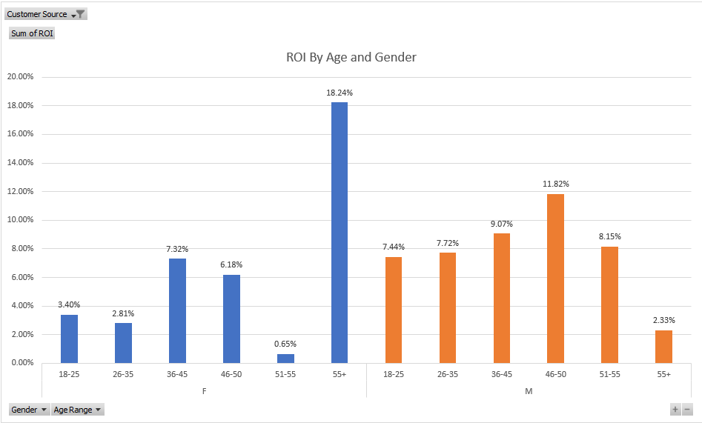
Evaluate the Marketing
Question: Were our Marketing efforts were successful, ROI is a useful metric, calculated as:
(Revenue-Cost)/Cost
It is 7.26%, which is positive for the paid channel, which is positive.
From the bar charts, it’s possible to see that the highest ROI by age group and gender, were a little far way from the rest, which was 55+ for Females (18.24%), followed by 46-50 for males (11.82%).

Slide 6
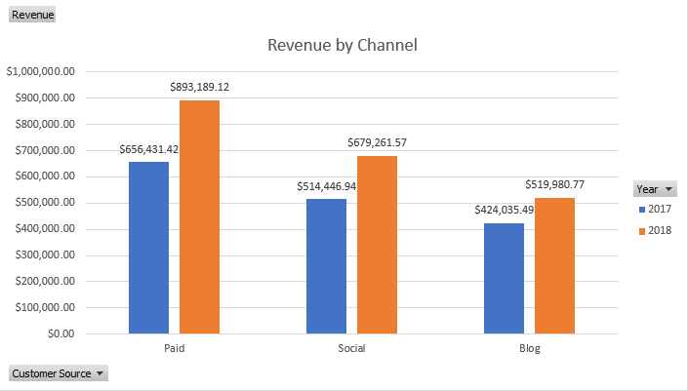
Evaluate the Marketing
Question: Which channel contributed most to sales?
We find that paid was the largest driver for both years, followed by Social and Blog.
The trends remained stable for both years.

Slide 7
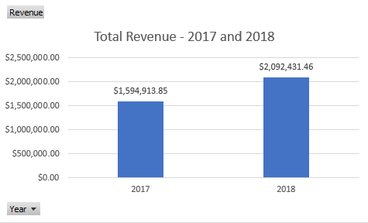
Evaluate the Sales
Question: How much revenue was generated over time?
A revenue of 1,594,913.85$ and 2,092,431.46$ were reported for 2017 and 2018, respectively.

Slide 8
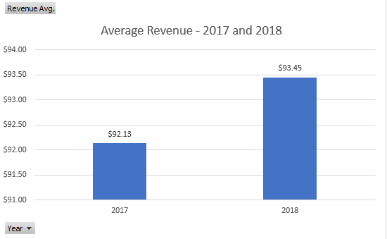
Evaluate the Sales
Question: What was the average revenue over time?
The average revenue was 92.13$ and 93.45$ in 2017 and 2018, respectively.

Slide 9
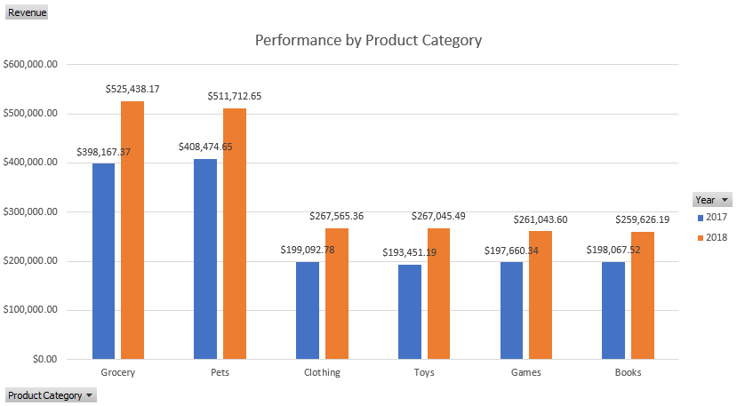
Evaluate the Product Categories
Question: Which were the most popular categories for both years?
The top revenue category for 2017 was Pets, while in 2018 it was surpassed by Grocery.

Slide 10
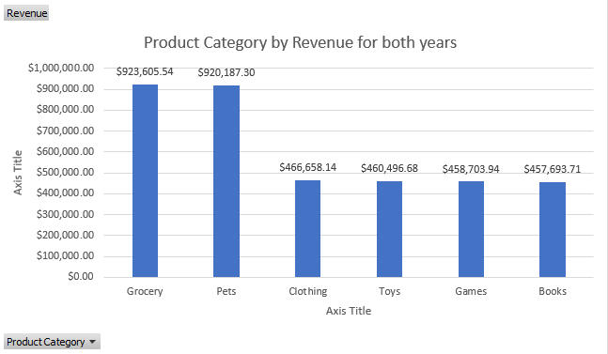
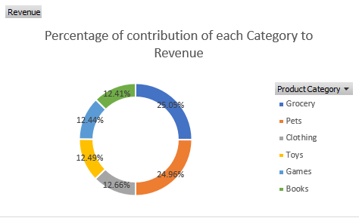
Evaluate the Product Categories
Question: What is the distribution of revenue by product category and its % of the total?
From the charts we can see that Grocery was the largest contributor (923,605.54$, 25.05%), followed by Pets (920,605.54$, 24.96%).
We can see that both these categories are very close in revenue generated.
The four remaining categories are approximately 12% of the total.

Slide 11
Everything Else
The dataset was merged in Excel to provide these findings in an easier way.
Further analysis can be conducted to extract insights from Cities and Newsletter subscriptions.
Sources:
https://www.laptopmag.com/articles/excel-2013-pivot-table-from-multiples

